Slide 1
MOBILE INTELLIGENCE 9 ESSENTIALS TRAINING
APPLICATION HANDBOOK

Slide 2
SUMMARY
SOLUTIONS AND MODULES…………………………….......... 3
INTRODUCTION TO MI PLATFORM………………………….. 31
HOME PAGE & SEARCH/LIST AREA……………………….... 39
CUSTOMER INFORMATION………………………………….... 51
PLANNER…………………………………………………………. 63
POST CALL………………………………………….................... 77
LIST BUILDER……………………………………………………. 85
REPORTS…………………………………………………………. 92
MI TOUCH INTRODUCTION……………………………………. 96

Slide 3
SOLUTIONS AND MODULES

Slide 4
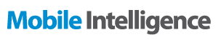
INTRODUCTION
What is Mobile Intelligence?
Mobile Intelligence is a CRM* (Customer Relationship Management) solution that is designed to address Life Sciences industry’s needs.
Notes:
CRM* is a software allowing clients to work and manage their own customers.

Slide 5




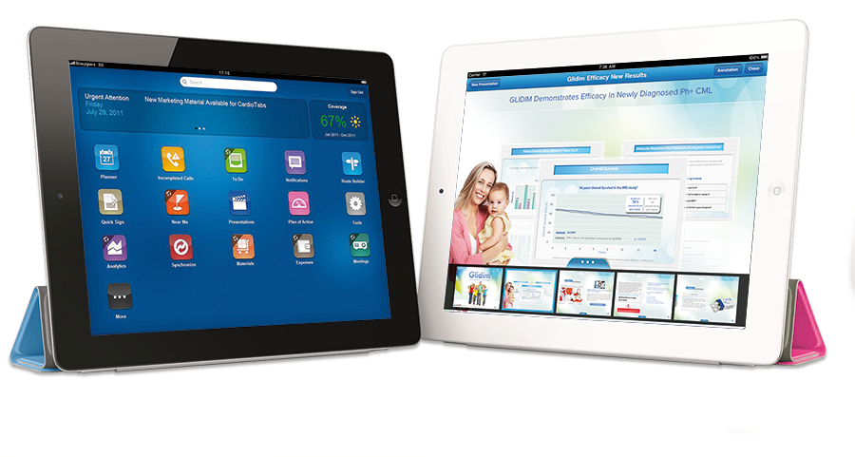
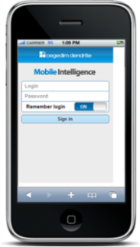
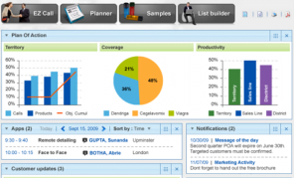
MOBILE INTELLIGENCE DEVICES & TECHNOLOGY

Slide 6
MOBILE INTELLIGENCE DEVICES & TECHNOLOGY
The Mobile Intelligence Solution is available for various devices
Solution | Device | Operating System | Application access
MI PC | Laptop and desktop | MS Windows | Offline: Application
 |  |  | Online: Browsers
MI Touch | Tablet | iOS | Apple App
MI Pocket | Smartphone | iPhone | Apple App
 |  | Black Berry | Browser
 |  | Android | Browser
MI Platform | Laptop and desktop | MS Windows | Browsers*
Notes:
* MI Touch administration is accessible via Safari

Slide 7
MOBILE INTELLIGENCE SOLUTION
The Mobile Intelligence Solution comes pre-packaged with Customer Management and Call Reporting modules
Additional modules can be added to suit pharmaceutical companies business needs for various roles within the company such as:
Primary / Specialty Care Sales Representatives
Pharmaceutical Representatives
Key Account Managers
Medical Science Liaisons managing Medical Inquiries
Home Office users in charge of Administration or Configuration tasks

Slide 8
MOBILE INTELLIGENCE MODULES
Feature | MI PC | MI Touch | MI Pocket
MODULES
Customer Profiling & Management | √ | √ | √
Call Scheduling & Reporting | √ | √ | √
Promotional Planning | √ | √ | √
Advanced Detailing (CLM) | √ | √
Budget, Congress & Meetings | √ | √
Coaching | √
Expenses | √ | √ | √
Material Management | √ | √ | √
Formularies | √
Surveys | √ | √ | √
Tender / Opportunity & Contracts | √
Objectives & Strategies | √ | √ | √
Medical Inquiry | √ | √ | √
Order Entry | √
Contact Center | √
Document Management | √ | √
MI Reports | √ | √
Available Modules in Mobile Intelligence
Notes:
A Client can purchase the modules either “à la carte,” meaning one-by-one, or they can request an “Enterprise” package, which includes all the available modules in the Mobile Intelligence solution at the time of the contract.

Slide 9




MOBILE INTELLIGENCE MODULES DESCRIPTION
 | Modules
 | Customer Profiling & Management | Integral Customer Management to ensure accurate up to date clean customer base 360º Customer Views by Activity, Channel, Segmentation… Influence networks & relationship tracking Quick Search by customer name Advanced Search by specialty, location, segmentation, organization to quickly find target groups Healthcare Structure display from the search to navigate through the hierarchy from search. Performance track metrics and measures on activity objective reach, sales, etc Advanced & dynamic ratings: at all levels: territory, therapeutic class, product, address…Automatic rating calculation based on segmentation criteria. Ladder of adoption/ incremental shift ratings
 | Call Scheduling & Reporting | Plan and schedule calls based on best time of your customers Route builder build and maintain routes Pre call analysis Flexible call with all the options to adapt to your business need: Call templates, Group call, Individual call Complete configurable call with all options: Key messages, call dialogue, samples, promotional material, tasks, surveys, rating updates Local process coverage: Use cycle planning and Early Post-Marketing Phase Vigilance (EPPV) based on your regional needs (for Japanese clients) Patient case tracking and shift (APAC mainly)
 | Promotional Planning | Integral promotion plan management: generation of a target customer list, target assignment to territory with capacity indicator, plan definition & distribution/publication Target & objective management: Option to define different customer segments in a period with a different reach objective and a different message Field consultation: Option to consult field users on the list and messages prior publication Execution follow up: Field and management reports associated to follow up plan achievement

Slide 10




MOBILE INTELLIGENCE MODULES DESCRIPTION
 | Modules
 | Advanced Detailing (CLM) | Interactive self adapting calls with multimedia presentation to customers using mobile devices iPad/Windows 8 Customer interest & reaction track to update customer profiling and segmentation Actionable CLM: Proposed next presentations based on earlier presentations learning Compliance ready: Signature Capture availability & Security lock once presentation has finished code is requested Marketing independency to manage presentations: capabilities to update, validate & precisely distribute content to a target team (sales, medical, KAM…) and a targeted audience (specialist, GPs, a given specialty…) Multimedia CLM usage track: which users present what, how frequently to which audience. This enables training departments to spot the needs.
 | Budget, Meetings & Congress | Manage Budgets: decide to share or control budget distribution through the field force structure Track Budget use: Track spent, estimated spend, remaining & reallocate remaining budget following business Track the activities & customer the budget was allocated to. Coordinate customer-focused sales and marketing initiatives such as speaker programs, conferences, and symposia Track information such as speaker, topic, attendees, location, dates, and budget Use inbuilt approval workflows for budgets
 | Coaching | Workflow-driven process enables field managers to review past coaching activities and schedule a coaching session Set up appropriate field coaching templates and evaluation criteria based on business needs Compare different team members on specific criteria
 | Expenses | Provides sales representatives to record their business expenses Workflow includes head office approval

Slide 11






MOBILE INTELLIGENCE MODULES DESCRIPTION
 | Modules
 | Material Management | Integral samples & material management of all material types: samples, coupons, devices, promotional items, or vouchers Sample management functions such as inventory management, shipments, transfers, and adjustments Transaction management: allocate items, request and order items, create and acknowledge shipments, disburse items as part of a call, transfer items between reps or return items to HO Inventory management: perform physical counts, create inventory adjustment transactions, system-calculated inventory
 | Formularies | Inclusion in formulary management: institution and managed care organizations product formulary inclusion management Formulary information can be shared with primary care users
 | Survey | Quick integral survey management creation consider different flows, conditions, type of answers (multiple choice, free text, etc.) targeted distribution & result tracking Flexible execution: from the call, from the customer profile, or integration in CLM materials Advanced Target: group of employees or customers Execution track
 | Tender / Opportunity & Contract | “Tender & Contract” provides the ability to follow the sales process from participation in tenders through contract to final contract sales figures Tender includes detailed information tracking, follow-up during bidding process until closing – if tender is won, it can be converted into contracts Tender includes detailed information tracking, follow-up during bidding process until closing – if tender is won, it can be converted into contracts
 | Document Management | Helps Home Office users to load approved documents in a centralized location and then dispatch to field users
 | MI Reports | 38 Pre-defined operational reports to Improve immediate business understanding as described on the above capability list

Slide 12



MOBILE INTELLIGENCE MODULES DESCRIPTION
 | Modules
 | Objectives & Strategies | “Tender & Contract” provides the ability to follow the sales process from participation in tenders through contract to final contract sales figures Tender includes detailed information tracking, follow-up during bidding process until closing – if tender is won, it can be converted into contracts Contract includes detailed information tracking and contract execution follow-up
 | Medical Inquiry | Medical Inquiry Capture: off-label questions from customers along with their signatures Medical Inquiry Answer Management: Medical Science Liaisons FAQ & Med Inquiry history repository management
 | Order Entry Management | Flexible order taking capability Tailored to work with retail establishments such as pharmacies, wholesalers, and distributors Automatic rules: discounts, payment conditions based on different price lists, promotions & purchasing groups Usability to copy last order and enhance it Invoice management gives an up-to-date view of ERP processed order in CRM Quota management defines a quota for a product in a specific period ensuring equal distribution of limited quantity product Reports History tracking: orders, commercial info, etc.
 | Contact Center | Customer search engine including search by phone number with good performance (aprox 4 seconds tested wiith a database the whole of Spain) Customer navigation: Option to navigate in hierarchy Search cases: by status, employee etc. Audit trail in all call center capabilities Template functions: to send mails or to send to printing agent (including different fields from CRM, pictures, etc) FAQ base Workflow: to assign cases Alarms in home page Order taking from call center Contact center reports: cases by type, customer, channel, resolution time, etc.

Slide 13
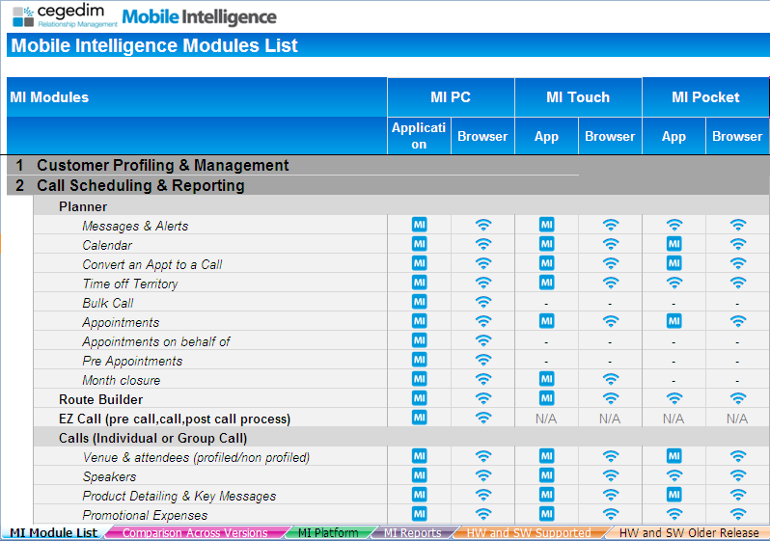


MOBILE INTELLIGENCE MODULES
This document is available on Intraone
Available without internet connection
Only available with an internet connection
MI Modules
Features
Details of Functionalities
Functionalities available
per MI versions
List of devices & versions compatibilities
(since MI 6)
List of devices & versions compatibilities
(up to MI 5.3)
List of MI Platform capabilities
List of MI reports
(« out of the box »)

Slide 14
ROLE AND MISSIONS OF THE SALES REPRESENTATIVES
The Primary / Specialty Care Sales Representatives’ calls are one way of promoting products of the pharmaceutical companies, alongside the press, medical sites and the organization of events.
Role and responsibilities:
The Sales Representative is responsible for promoting products on their appropriate use. He/she is in direct contact with Health Care Professionals.
Informing physicians on the drugs
Answering questions on the drugs (efficiency, tolerance, potential side effects)
Conditions & Work environment:
Work location: Medical Professionals’ practices
Contacts: General Practitioners / Specialists
A Sales Representative is responsible for a Territory (or alignment)

Slide 15


PRIMARY / SPECIALTY CARE REPS
Feature | MI PC | MI Touch | MI Pocket
MODULES
Customer Profiling & Management | √ | √ | √
Call Scheduling & Reporting | √ | √ | √
Promotional Planning | √ | √ | √
Advanced Detailing (CLM) (Available on MI 9) | √ | √
Budget, Congress & Meetings | √ | √
Coaching | √
Expenses | √ | √ | √
Material Management | √ | √ | √
Formularies | √
Surveys | √ | √ | √
Tender / Opportunity & Contracts | √
Objectives & Strategies | √ | √ | √
Medical Inquiry | √ | √ | √
Order Entry | √
Contact Center (Available on MI 9) | √
Document Management | √ | √
MI Reports | √ | √
For Primary Care
or Specialty Care
(They visit GPs and/or specialty healthcare professionals in practice, group practice, clinic)
Notes:
Highlighted modules = potential/commonly modules attributed to a Primary/Specialty Care Sales Representative
(other modules can also be delivered to the client)

Slide 16
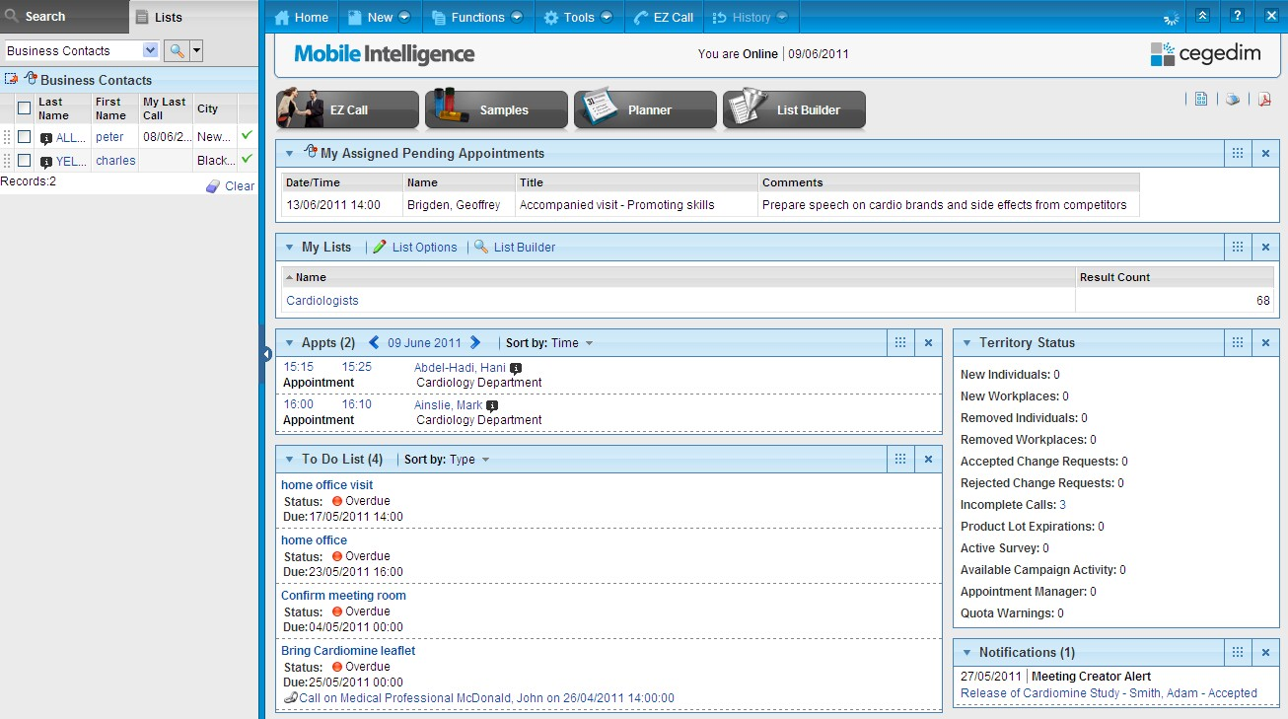
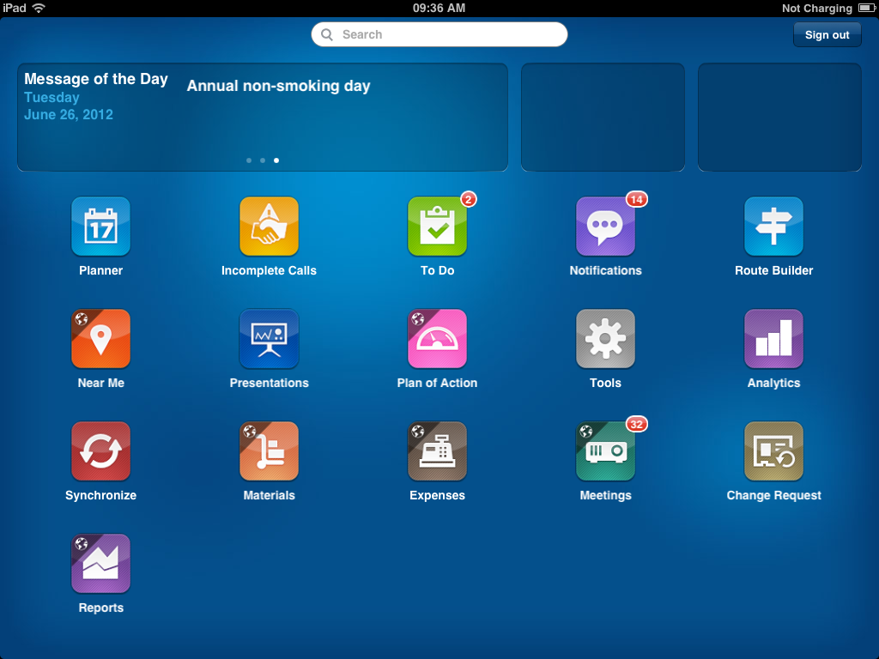
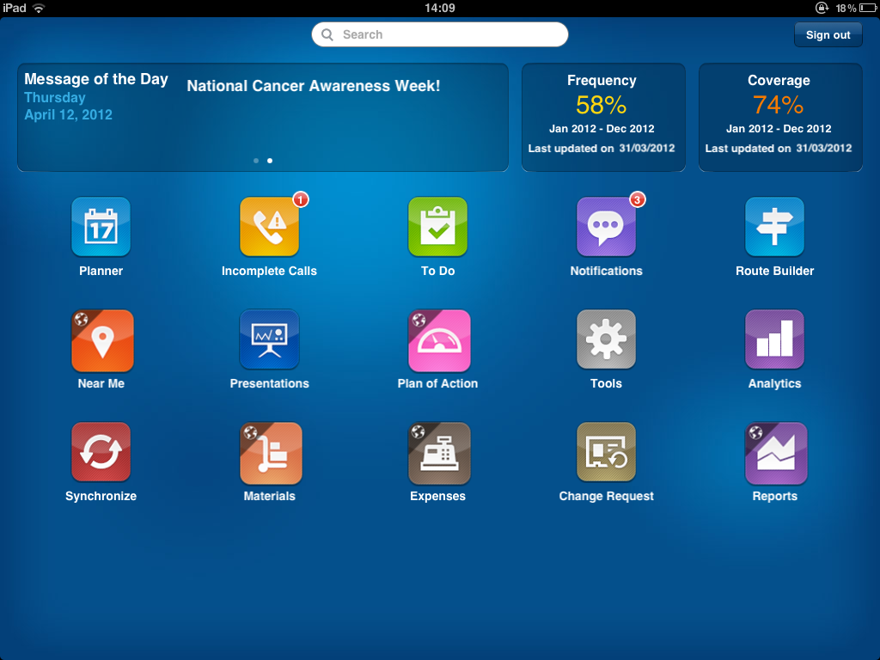
PRIMARY / SPECIALTY CARE REPS
MI PC home page
MI Touch home page

Slide 17
ROLE AND MISSIONS OF THE HOSPITAL REPRESENTATIVES/KEY ACCOUNT MANAGERS
The hospital market:
The hospital sector is a high stake for pharmaceutical companies because of the strong influence of hospitals on general practice and the fact that general practitioners are reluctant to modify prescriptions initiated in hospitals.
Roles and responsibilities
The KAM is responsible for creating and improving relationships with key people (Medical Professionals, Pharmacists) working in hospitals and promoting products on their appropriate use.
Informing physicians on the drugs
Answering questions on the drugs (efficiency, tolerance, potential side effects)
Negociating Tenders & Contracts, Formularies…
Conditions & Work environment:
Work location: Hospitals
Contacts: Hospital practitioners, paramedical staff (nurses, midwives, physiotherapists, etc), Hospital managing staff…

Slide 18

HOSPITAL REPS / KEY ACCOUNT MANAGERS (OBJECTIVES AND STRATEGIES)
Feature | MI PC | MI Touch | MI Pocket
MODULES
Customer Profiling & Management | √ | √ | √
Call Scheduling & Reporting | √ | √ | √
Promotional Planning | √ | √ | √
Advanced Detailing (CLM) (Available on MI 9) | √ | √
Budget, Congress & Meetings | √ | √
Coaching | √
Expenses | √ | √ | √
Material Management | √ | √ | √
Formularies | √
Surveys | √ | √ | √
Tender / Opportunity & Contracts | √
Objectives & Strategies | √ | √ | √
Medical Inquiry | √ | √ | √
Order Entry | √
Contact Center (Available on MI 9) | √
Document Management | √ | √
MI Reports | √ | √
Key Account Managers
(They improve relationships with key people within organizations)
Notes:
Highlighted modules = potential/commonly modules attributed to a Key Account Manager
(other modules can also be delivered to the client)

Slide 19
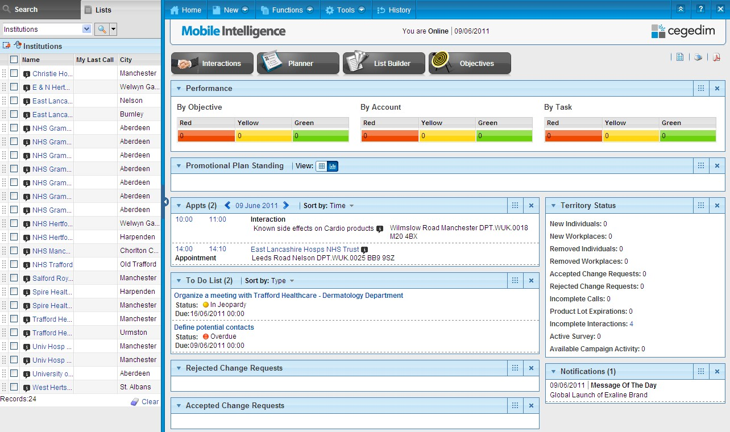
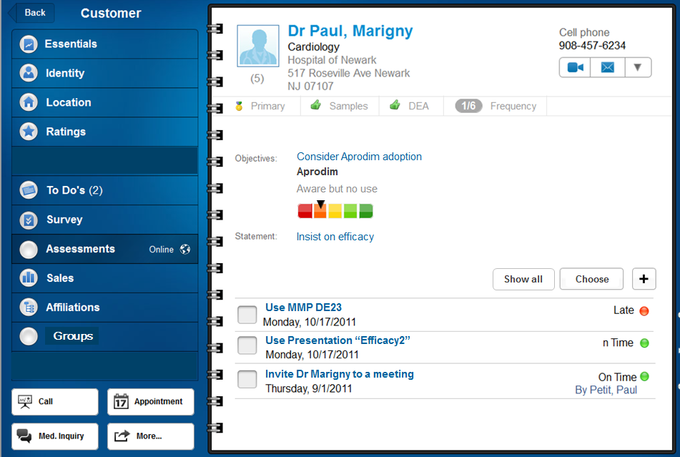
HOSPITAL REPS / KEY ACCOUNT MANAGERS
MI PC home page
MI Touch Account Planning & Management feature for Account Teams

Slide 20
MEDICAL SCIENCE LIAISONS
A KOL (Key Opinion Leader) is a physician who influences his/her peer’s medical practice on prescription behavior
The Medical Science Liaison (MSL) is a resource person with a scientific profile answering questions about product use and effects and is dedicated to manage KOL contacts
As an expert, the MSL uses Mobile Intelligence to manage KOL profiles and answer Medical Inquiries coming from the company’s Representatives, Call Center users, or from the general public as well as Medical Professionals

Slide 21













MEDICAL SCIENCE LIAISONS
SFPT / Pharmacology and therapeutic Medical Society
Scientific profile:
3 Publications in major journals
Lead investigator in 2 Clinical trials
BERNAUD
BLAYAC
BLIN
BORDET
BRUGUEROLLE …
Dr Anna L.
20 relationships
Hotel Dieu Hospital
HAS / Medicine Agency
SMHP / Paris Hospital Medical Society
AUTRET LECA
BANNWARTH
BARDOU
BOUVENOT
CARIOU
…
MAMBRE
MUNERA
OLIVIER DI CARMINE
…
LECHEVALIER
SERENI
32 relationships
26 relationships
22 relationships
100 “official” relationships throughout medical and institutional activities
Notes:
HAS: Haute Autorité de Santé or French National Authority for Health deals with the assessment of drugs, medical devices, the procedures of publication for guidelines, accreditation of healthcare organizations and certification of doctors
SMHP: Société Médicale des Hôpitaux de Paris, the goal of this society is to organize congress between physicians to debate about different topics
SFPT: Société Française de Pharmacologie et de thérapeutique

Slide 22


MEDICAL SCIENCE LIAISONS (MEDICAL INQUIRY MANAGEMENT)
Feature | MI PC | MI Touch | MI Pocket
MODULES
Customer Profiling & Management | √ | √ | √
Call Scheduling & Reporting | √ | √ | √
Promotional Planning | √ | √ | √
Advanced Detailing (CLM) (Available on MI 9) | √ | √
Budget, Congress & Meetings | √ | √
Coaching | √
Expenses | √ | √ | √
Material Management | √ | √ | √
Formularies | √
Surveys | √ | √ | √
Tender / Opportunity & Contracts | √
Objectives & Strategies | √ | √ | √
Medical Inquiry | √ | √ | √
Order Entry | √
Contact Center (Available on MI 9) | √
Document Management | √ | √
MI Reports | √ | √
MSL (Medical Science Liaison) and Call Centers
They answer medical inquiries and update KOL information
Notes:
Highlighted modules = potential/commonly modules attributed to an MSL
(other modules can also be delivered to the client)

Slide 23
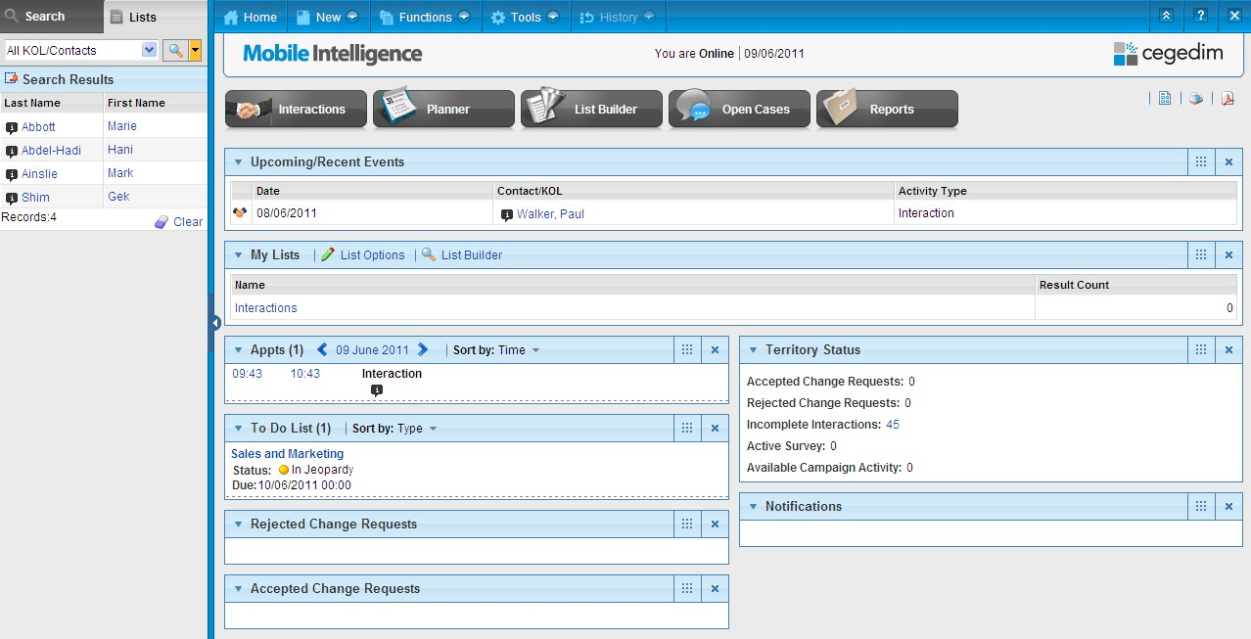
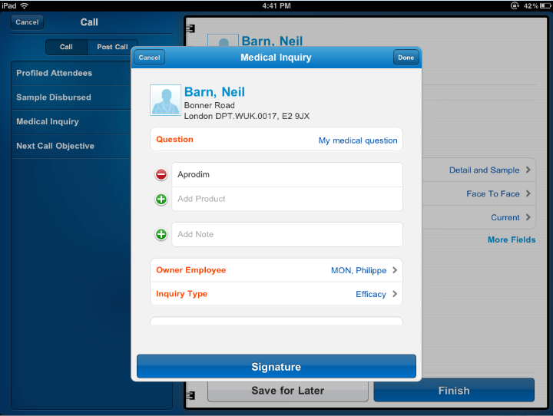
MEDICAL SCIENCE LIAISONS
MI PC home page
Medical Inquiries on MI Touch

Slide 24
ROLE AND MISSIONS OF THE PHARMACEUTICAL REPRESENTATIVES
The retail pharmaceutical market:
It consists of reimbursable prescription drugs, non reimbursable prescription drugs and drugs sold without prescription
Role and missions of the pharmaceutical representative:
The Pharmaceutical Representative is responsible for promoting and selling OTC products in pharmacies and wholesalers.
He/she is NOT in direct contact with Physicians
Conditions & Work environment:
The main contacts are retail pharmacists and wholesalers.

Slide 25









PHARMACEUTICAL REPRESENTATIVES
Pharmaceutical companies have representatives dedicated to visiting pharmacies, clusters, etc. and to taking orders on these customers.
Customer
Possible Exchange or Recall
Delivers the products
Orders products
Distributor
Representative
HO
Processes the order
Enters the Order Submits to Validation
Notes:
A Cluster is an Organization whose affiliates are interconnected pharmacies, providing them with recommendations and tools regarding their management enhancement, inventory keeping and commercial policy. It enables its members to benefit from the same commercial offers on pharmaceutical products to harmonize the market prices.

Slide 26
PHARMACEUTICAL REPRESENTATIVES (ORDER ENTRY)
Feature | MI PC | MI Touch | MI Pocket
MODULES
Customer Profiling & Management | √ | √ | √
Call Scheduling & Reporting | √ | √ | √
Promotional Planning | √ | √ | √
Advanced Detailing (CLM) (Available on MI 9) | √ | √
Budget, Congress & Meetings | √ | √
Coaching | √
Expenses | √ | √ | √
Material Management | √ | √ | √
Formularies | √
Surveys | √ | √ | √
Tender / Opportunity & Contracts | √
Objectives & Strategies | √ | √ | √
Medical Inquiry | √ | √ | √
Order Entry | √
Contact Center (Available on MI 9) | √
Document Management | √ | √
MI Reports | √ | √
For Pharmaceutical Representatives
(They visit pharmacies and wholesalers to sell products)
Notes:
Highlighted modules = potential/commonly modules attributed to a Pharmaceutical Representative
(other modules can also be delivered to the client)

Slide 27
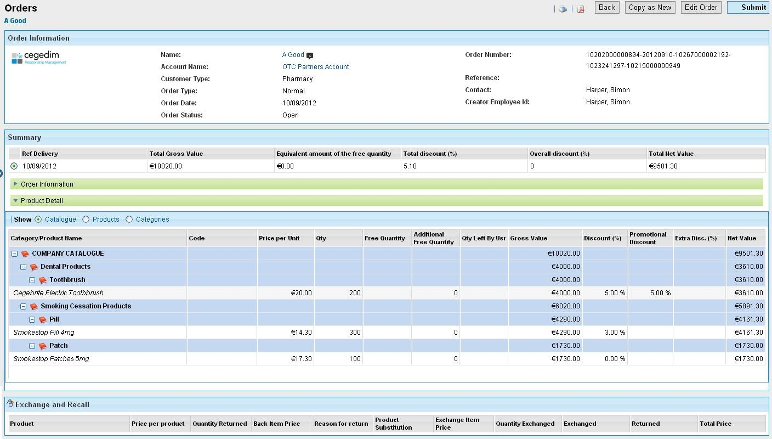
PHARMACEUTICAL REPRESENTATIVES
MI PC Order Form

Slide 28
ROLE AND MISSIONS OF MANAGERS
Role:
Implement the commercial strategy of the company to develop a given district. Manage and build a team of sales, hospital or pharmaceutical representatives.
District Managers (DM) supervise field users (e.g.: Sales rep, KAM, MSL, Pharmaceutical reps)
Regional managers (RM) supervise DMs and field users (e.g.: Sales rep, KAM, MSL, Pharmaceutical reps)
Head Office (HO) supervises RMs, DMs and field users (e.g.: Sales rep, KAM, MSL, Pharmaceutical reps)
Missions:
Supervise, validate and follow up the achievement of plan of actions for each employees’ alignment (accompanied visits, administrative follow up, budget…)
Build and implement the plan of actions
Manage and develop the HR aspect of the district (recruitment, evaluation, training…)
Train and inform sales representatives on the products and services
Organize meetings at district, region and national level with field force.

Slide 29
COMPANY STRUCTURE
Home Office
(HO)
Regional Manager 1
(RM)
Regional Manager 2
(RM)
District Manager 1
(DM)
District Manager 2
(DM)
District Manager 3
(DM)
District Manager 4
(DM)
Sales Rep
KAM
Sales Rep
Pharma Rep
MSL

Slide 30

ADMINISTRATIVE ASSISTANTS
The Contact Center module enables an administrative assistant to generate mass appointments on behalf of a Sales Representatives.
Generally used by an external agency, it could also be used by an internal department in a pharmaceutical company.
Home Office, District managers or reps build a contact list of appointments to be taken. This list is shared with assistant. The list facilitates the communication between all parties. The solution provides relevant reports including number of appointments taken.

Slide 31
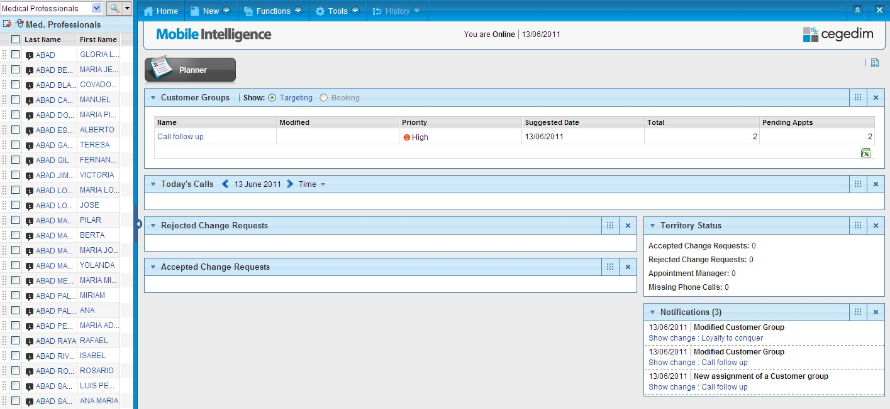
ADMINISTRATIVE ASSISTANTS
Booking service home page

Slide 32
INTRODUCTION TO MOBILE INTELLIGENCE PLATFORM

Slide 33


MOBILE INTELLIGENCE PLATFORM USERS
The Mobile Intelligence platform refers to the architecture and the software framework where the application runs and can be configured.
The Mobile Intelligence platform includes Configuration, Administration and, Extract, Transform and Loading (ETL) capabilities.
Platform capabilities are accessed via online Internet browser on a PC (Safari is required for MI Touch configuration).
MI Platform
 | Platform Administration | Capabilities for Administrators to carry out the business changes Organizational hierarchy (Employees and Teams, Alignments, Geographies, Regions, Business Units), Markets and Products (Product hierarchies, Assigning to Teams), Realignment Lists & Rules, Security Group and Users
 | Platform Configuration | Enables users to modify the visual layer of the application and enhance functional behavior within the parameterization and the dependencies perimeter
 | CEGEDIM ETL | Capabilities to import and export data
Notes:
Mobile Intelligence Platform users: Refers to the people either from the pharmaco, from the Cegedim partner, or from Cegedim who will access the platform to carry out administration, configuration, or extracting and loading tasks. Platform users must be trained and certified by Cegedim.

Slide 34
PLATFORM ADMINISTRATION
The Platform Administration provided inside Mobile Intelligence is designed to manage the company structure
With the Platform Administration, it is possible to:
Create and manage Employees, Users, Teams
Create and manage Products, Customer alignments
Etc…
Who has an access to the Platform Administration?
Administration can be performed:
Internal Cegedim staff (implementation teams)
Home Office staff members within the pharmaceutical company

Slide 35

ADMINISTRATION WORKFLOW
REGION
BU
REALIGNMENT LISTS
PRODUCTS
TEAM
REALIGNMENT RULES
GEOGRAPHIES
ALIGNMENT
Role
Manager
EMPLOYEE
BU creation is optional in the system
User Template
ID + password
Security Group(s)
USER
Notes:
Region:
- A geographic area that a client treats as a separate organization
Business unit:
- Divisions in the same company not governed by geography (Ex: Animal Health / Human Health)
Geography (Geographic Segmentation):
- A set of geographic entities, generally including bricks
The geographic area allows the administrator to constitute the territory structure
Team:
A group whose members have an access to specific products they can use during presentations to customers, when distributing samples, during events, etc.
Alignment (Territory):
The link between the Territory and the Team to which the Employee belongs to
The alignment is made of geographic entities
Realignment Rules:
The definition of the population to allocate to each team
Employee:
An individual who works within the pharmaceutical company
User:
An employee who has an access to Mobile Intelligence
This employee has an ID and a password and belongs to a security group that gives him authorizations set in the application
Security group:
A group whose members can access Mobile Intelligence functionalities (view or edit mode). These different accesses are set depending on authorizations
User Template:
Used to define a specific user profile and automatically generating user accounts after the employee creation

Slide 36
PLATFORM CONFIGURATION
While the Platform Administration of Mobile Intelligence is used to add Client data to the system such as, Employees, Teams, Products; the Platform Configuration is used to manage the overall appearance and behaviour of the application
The Configuration of MI includes:
Modification of Parameters
Modification of Screen layout
The Configuration is managed by:
The Configurator of Mobile Intelligence
Internal Cegedim Staff (implementation teams) or Home Office staff members within the pharmaceutical company

Slide 37










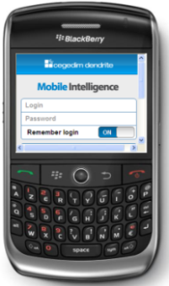
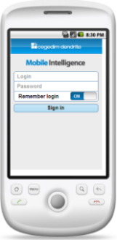
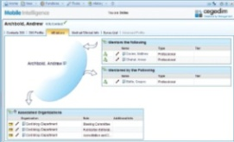
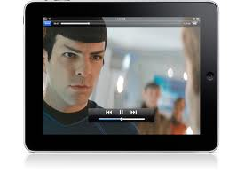
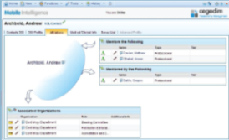
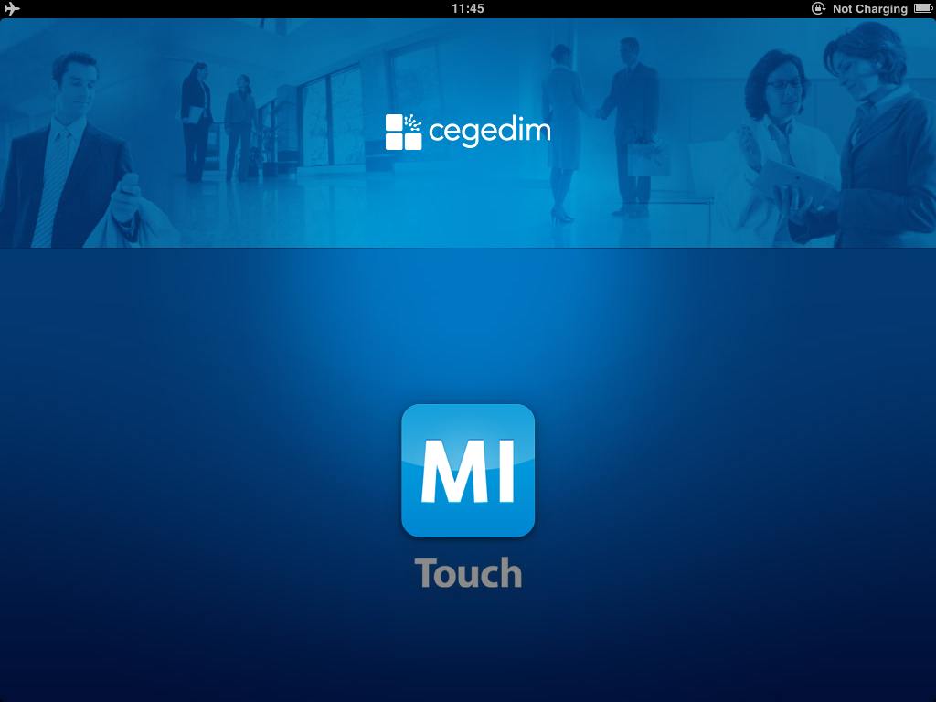

USER ACCESS OPTIONS
Online
Classic Offline
The connected user app
Full MI application when using the Internet Browser
Standalone solution
Full MI application
Cegedim Cloud
MI Touch / Pocket
Mixed offline or online
Instant-on application
Multimedia detailing
Test Sandbox
Production
Configuration Sandbox
Internet Browser (full application)
Synchronization Manager
Internet Browser (full application)
Online Platform Configurator
Online
Platform Administrator
Internet Browser
(full application)
Blackberry
Android
Ipad
iPhone
Laptop
(full application)
(MI Pocket)
Online
MITouch / MI Pocket
Classic Offline
Notes:
37
All the different roles into Pharmaceutical Companies are potential users of Mobile Intelligence:
the field force (Sales Representatives, Medical Science Liaisons, Key Account Managers, Pharmaceutical Representatives, District Managers, Regional Managers, Home Office),
the MI platform users (Home Office staff members).

Slide 38
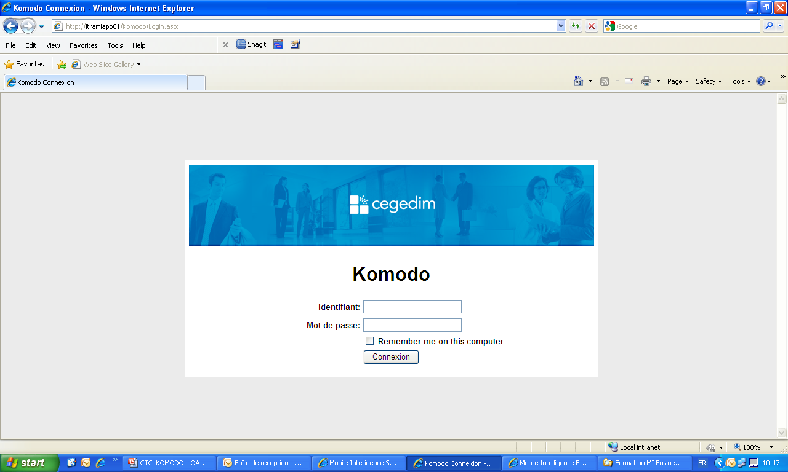
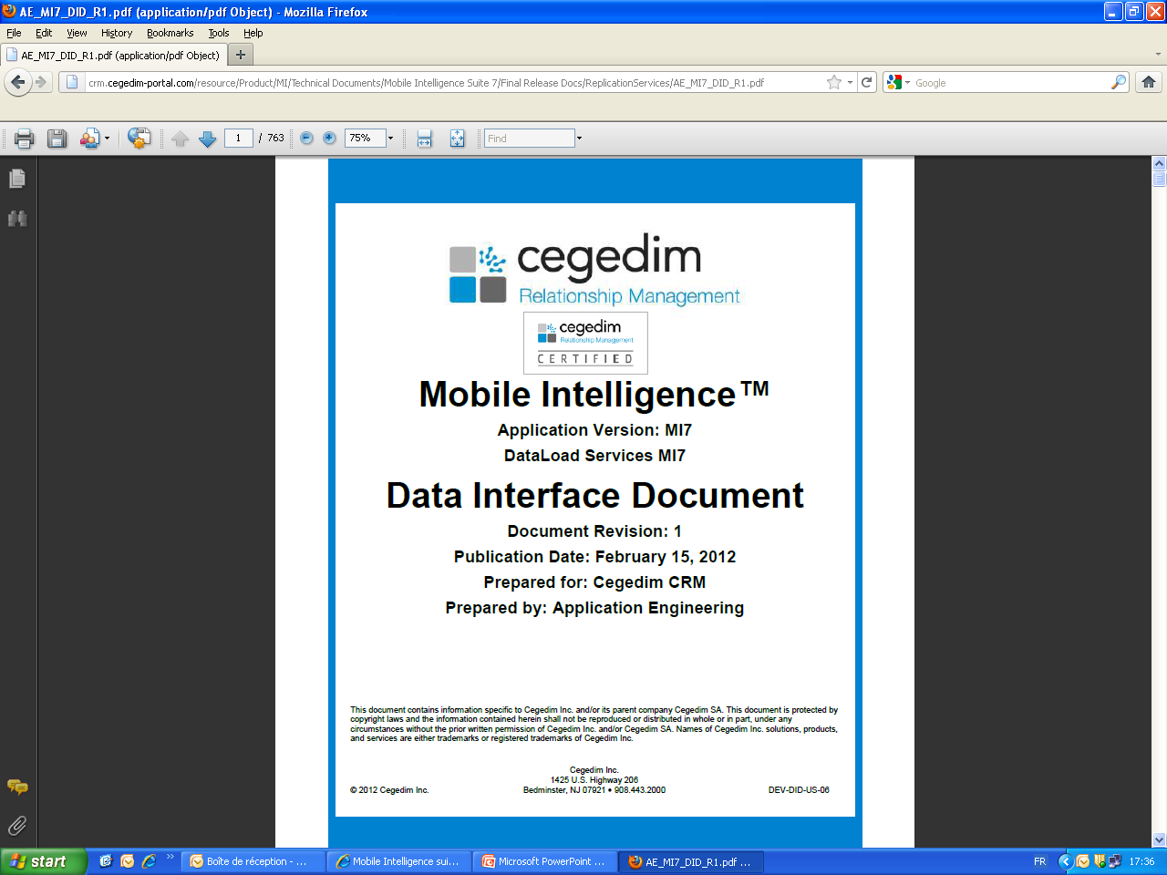
MI ETL INTRODUCTION
Definition:
Komodo is a standalone tool used to load and extract data into and from Mobile Intelligence such as Employees, Teams, Products…
DID must be used to format correctly the files
Notes:
DID: Data Interface Document

Slide 39
MOBILE INTELLIGENCE PLATFORM
Standard Access | Advanced Access
PLATFORM ADMINISTRATION Employee & User Management Product Management Business line (team) Management Territory (Alignment) Management MI Services monitoring Version Promotion (including across tenants) Region/ Business Unit Management Geography Management Explicit Alignment & Exclusions Territory Hierarchy Data Sharing Rules Management Remote database creation | ADMINISTRATION n/a
PLATFORM CONFIGURATION Version Control Page lay out configuration (show, hide, move) Parameterization List of Values Labels & Language Business rule- dependencies Print page configuration Web links Functional switch on/off (security Functions) | CONFIGURATION New fields, sections, tables, objects on Entity level Scripting Configuration Business Rules Table joints Buttons to launch other functions Look ups to tables Pre-defined List management MI Report Configuration Workflow Configuration
CEGEDIM ETL* Data import interface execution Data export interface execution | CEGEDIM ETL* Ad hoc Interface building Standard interface modification
Notes:
*Extract Transform Load

Slide 40
HOME PAGE & SEARCH / LIST AREA

Slide 41
THE HOME PAGE: THE HEART OF MI
The Home Page gives access to all Mobile Intelligence features. It is where data and information on Customers will be collected (Medical Professionals, Organizations…).
Critical information is accessible from the ‘web-page’ area:
Urgent items and notifications from Home Office
To-Do items
View the summary of new Customers in the user’s alignment (territory)
Easy to navigate using ‘web-like’ functionality
Time saving search for critical information

Slide 42
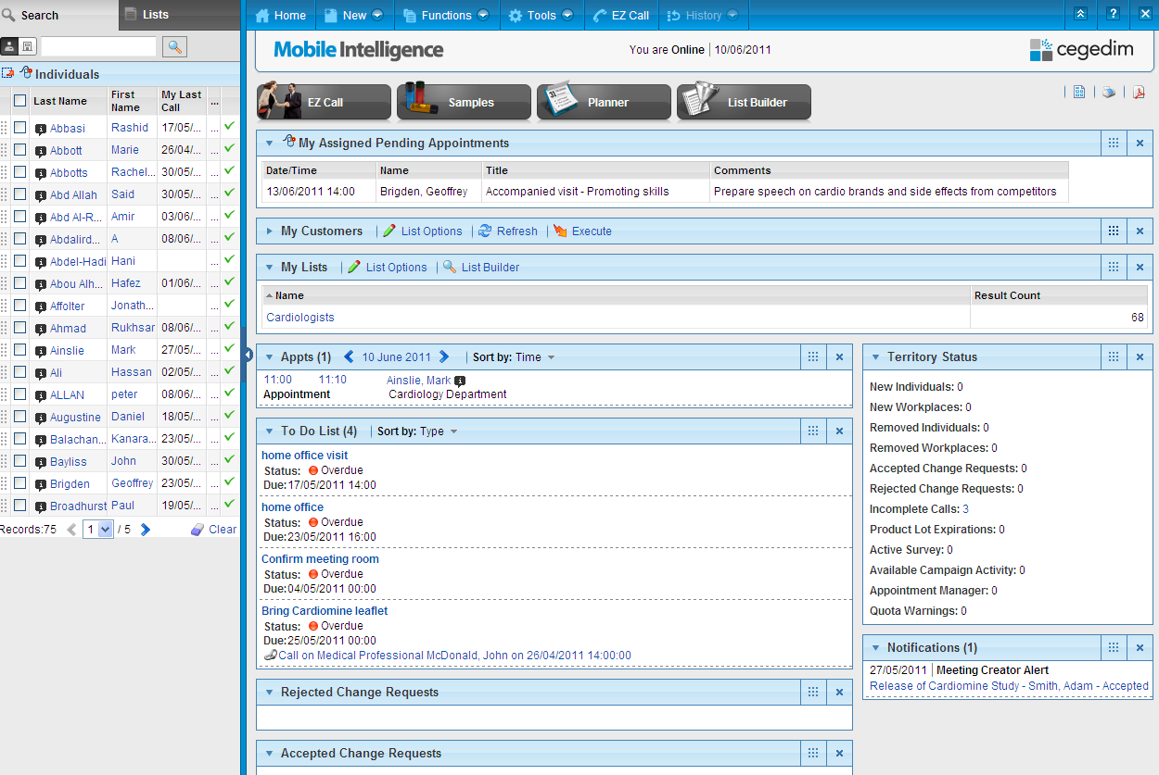
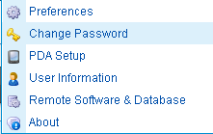
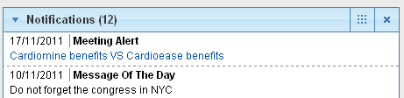
HOME PAGE
WHAT CAN BE FOUND ON THE HOME PAGE?
To hide the info bar
To return to the Home Page
The Tools menu gives access to the users’ password modification
The shortcut gives direct access to the modules
To change the Page Layout
The hyperlink gives
direct access to the
information details
These sections can be moved or hidden
Tips: F11 function key enables to hide the menu bar on top of the screen. Consequently, the screen is able to show more information.
Notes:
42

Slide 43
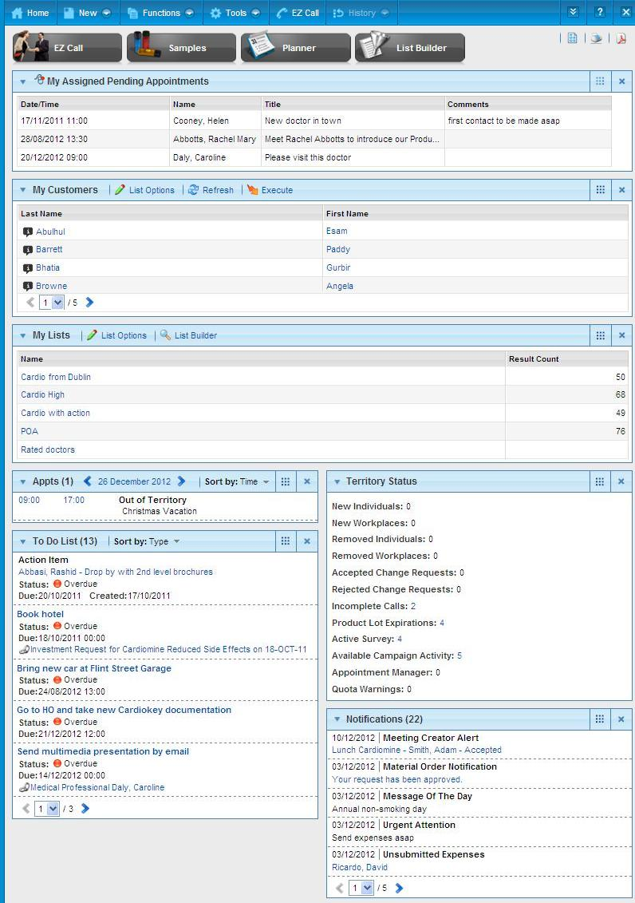
HOME PAGE
WHAT CAN BE FOUND ON THE HOME PAGE?
List of my main customers
Pre appointments taken by the user’s manager
My favorite Lists from the
list builder
Important
information
about the user’s alignment
Relevant information about activities from the planner (calls, appointments, Time Off Territory and meetings)
Important tasks
to accomplish
Message of
the day coming
from the hierarchy
Notes:
43

Slide 44
CUSTOMER TYPES IN MOBILE INTELLIGENCE
Customers
Individuals
Organizations
Medical Professionals
Institutions
Business Contacts
Departments
Pharmacies
Wholesalers
The information retrieved in the Search/List area comes from OneKey or from the client database.
Practices
Managed Care Organizations (MCO)
Group Purchasing Organizations (GPO)
Clusters
Notes:
The Individuals are composed of:
A Medical Professional is a person who provides human healthcare, such as a Medical Doctor, Nurse Practitioner or Physicians Assistant.
A Business Contact is an influential person who is not a medical professional, such as a contract and formulary administrator, hospital director, journalist.
An Organization customer is considered a legal entity that is not an individual, but for which you can record a call. Organization customers can be one of the following customer types:
An Institution is an organization such as a hospital, nursing home, clinic, hospice, VA or military, surgery center, psychiatric facility, or correction facility.
A Department is an organization sub-type that is part of an institution, such as an emergency room, cardiac CCU, or pediatric unit. There can be many departments for a single institution.
A Pharmacy is an organization such as an independent drug store or a drug store chain.
A Wholesaler is an organization that performs activities related to procuring, holding, and supplying or exporting medicinal products, but does not supply these products to the public. These activities are carried out with manufacturers, importers, other wholesale distributors, or persons supplying to the public. (Only available for Key Account Management and Order Entry users.)
A Practice is an organization such as a free-standing surgery center or a group practice.
A Managed Care Organization (MCO) is an organization such as a Health Maintenance Organization (HMO), Pharmacy Benefit Manager (PBM), or Preferred Provider Organization (PPO).
A Group Purchasing Organization (GPO) is an organization such as a nursing home provider or buying group provider that helps healthcare entities achieve cost-savings by aggregating purchasing volume to obtain discounts.
A Cluster is an Organization whose affiliates are interconnected pharmacies, providing them with recommendations and tools regarding their management enhancement, inventory keeping and commercial policy. It enables its members to benefit from the same commercial offers on pharmaceutical products to harmonize the market prices.

Slide 45
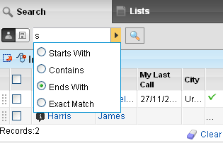
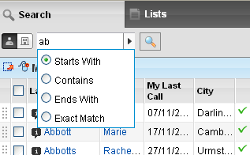
HOW TO USE THE SEARCH/LIST AREA?
Users can refine the search using an intuitive search
Search to last name of the individual or the organization
Here, the individuals
having a last name
starting with ‘ab’
Here, the individuals
having a last name
finishing with ‘s’
When the criteria selected are different from the default ones, the arrow button is yellow:

Slide 46
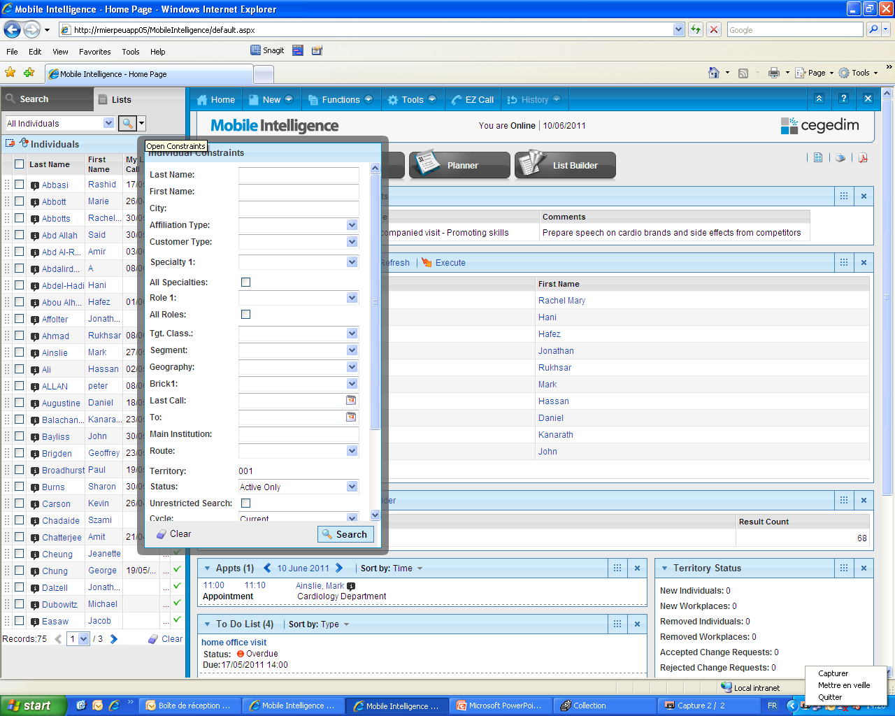
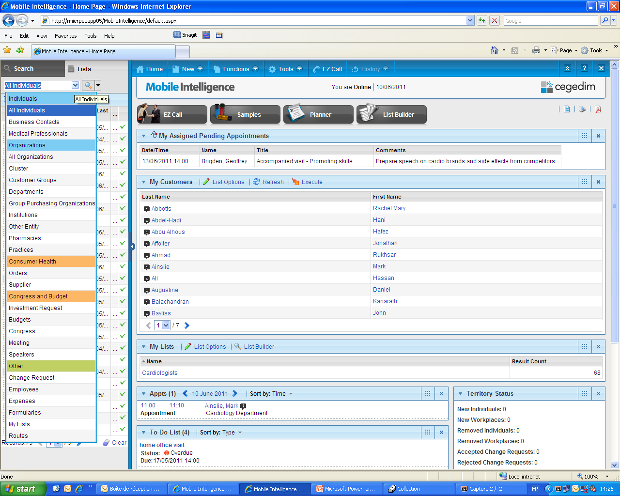
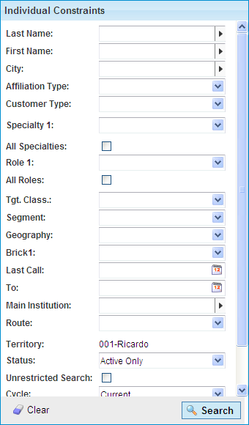
HOW TO USE THE SEARCH/LIST AREA?
List for more detailed search
The user can search by Customer Type
Use the arrow button to refine the search based on specific criteria.
For online users only:
When ticking the Unrestricted Search box, all the customers of the database are displayed.
When the criteria selected are different from the default ones, the arrow button is yellow:

Slide 47
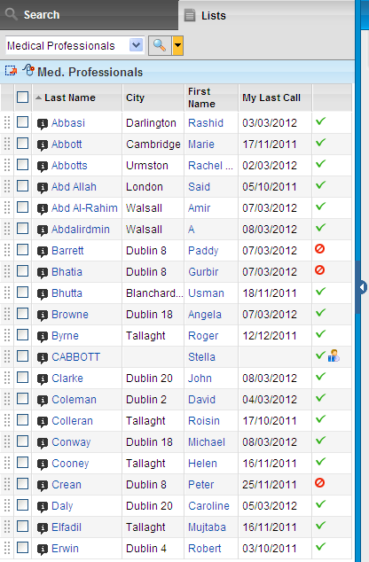
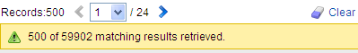
HOW TO USE THE SEARCH/LIST AREA?
The customer is currently aligned to this alignment
It is possible to hide the search zone
The customer who has been added with a change request, but has not yet been validated by OneKey team
The customer will be assigned to this alignment in the future
Results are limited to 500 records

Slide 48
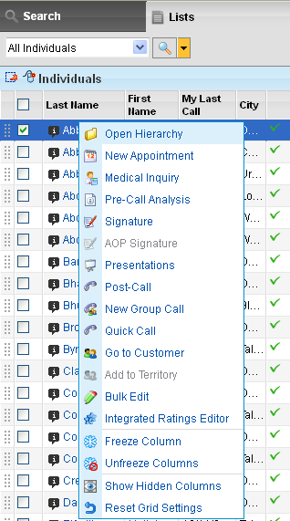
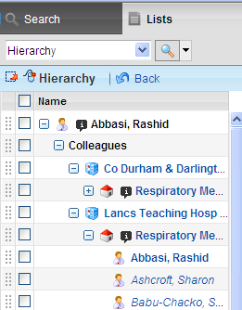
HOW TO USE THE SEARCH/LIST AREA?
It is possible to
drag from this area
when this symbol is
on the screen
The Back button allows
the user to go back to the
previous menu
The user can quickly display the hierarchy for the selected customer
A right click opens a menu allowing to perform actions with the selected customer and thus navigating towards other parts of the system
Each Customer Type has a symbol.
Here a Medical Professional
is indicated
The hyperlink gives
direct access to the
customer profile

Slide 49
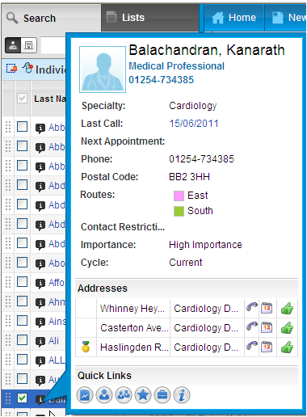
HOW TO USE THE SEARCH/LIST AREA?
The Info Tip provides crucial information at a glance.
The Primary Address of this customer is indicated with a yellow medal symbol.
Click on the Quick links to access other customer information.

Slide 50
SOME MAJOR ICONS IN THE INFO TIP
Icons | Definitions
 | Direct access to the Essentials tab that provides information regarding appointments and calls.
 | Direct access to the Details tab that provides a summary of customer information mainly maintained by OneKey.
 | Direct access to the Networks tab that provides information on colleagues practicing in the same institution as well as information linked to the Medical professional’s network (hard and soft affiliations).
 | Direct access to the Ratings tab that provides qualifying information on the customer.
 | Direct access to the Activity tab that provides the contacts history on the Medical Professional.

Slide 51
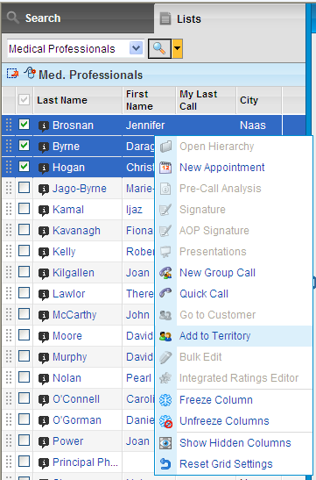
HOW TO USE THE SEARCH/LIST AREA?
Self Alignment allows online end-users to easily add Customers to their alignment, thus reducing the need for large alignments to begin with.
The users can handle this without the need to request support from Administrator.
Only appears when customer is not already in the alignment.
Notes:
This functionality is not activated by default in the baseline.

Slide 52
CUSTOMER INFORMATION

Slide 53

CUSTOMER INFORMATION DEFINITION
The Customer information provides all data on the customer including:
Detailed Customer information
Customer management
Information can come from OneKey or can be client database
Users can access critical information such as:
Address information
Contacts history and appointments
Hierarchy (Affiliations)
Influence network
Ratings
Documents

Slide 54
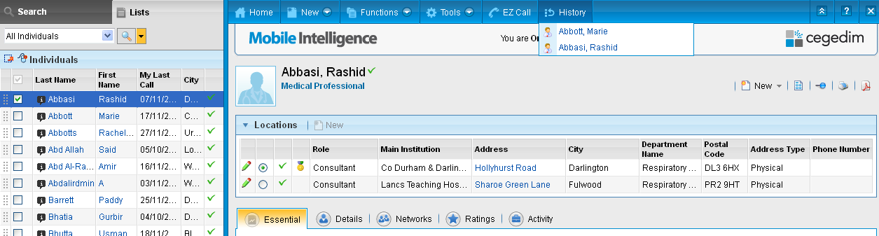

CUSTOMER INFORMATION VIEWING CUSTOMER INFORMATION
Clicking the customer name in the Search/List area, opens the customer profile:
The History menu allows the user to go back to customers
previously looked up during the current session
The Locations section details all professional addresses. The primary address is indicated with a yellow medal
Users can navigate through the various tabs to easily find information

Slide 55
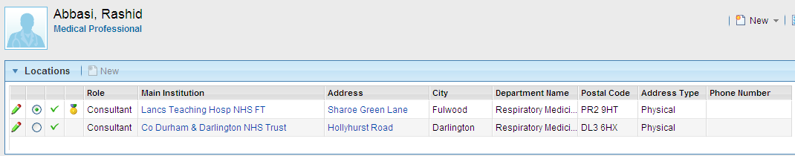
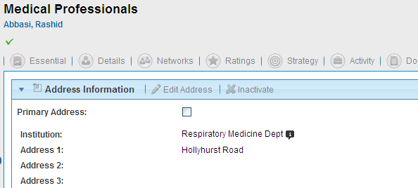
CUSTOMER INFORMATION PRIMARY ADDRESS
The main institution link allows the user to open the customer profile of the organization where this medical professional works
All users can modify the Primary address for their customers. This information is personal for the users.
The Edit Address button allows the user to change the primary address. The primary address will always appear in first position on the customer profile.

Slide 56
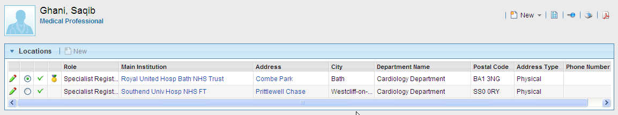

CUSTOMER INFORMATION PRIMARY ADDRESS
In Mobile Intelligence, all users recover all the addresses of a customer aligned to them and see for each of their customers the flag on the primary address.
The primary address is calculated according to specific parameters
For Pharma companies using Mobile Intelligence and OneKey data, the primary address is provided on all Individuals of the OneKey database.
However, other criteria are to also taken into consideration in order to calculate the primary address within Mobile Intelligence.
Primary address calculation method may vary from one version of Mobile Intelligence to another.

Slide 57
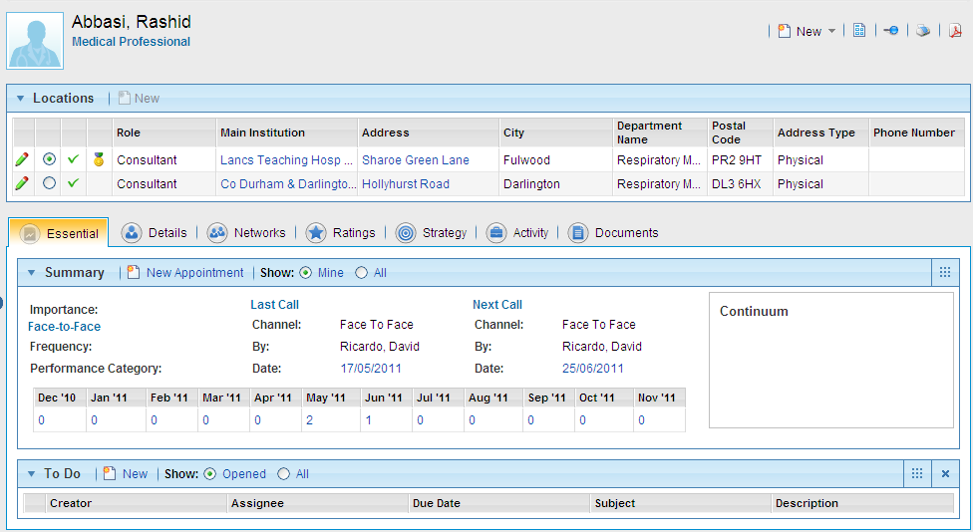
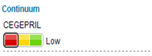
CUSTOMER INFORMATION VIEWING INFORMATION: ESSENTIAL TAB
Changing the address selection may modify data displayed in some tabs such as ‘Best Times’
The Essential tab gives a summary of calls and appointments
It is also possible to have information concerning the adoption level for a product (Continuum POA)
The grid sums up the number of appointments, calls and Investment Requests (Meetings) on each month

Slide 58
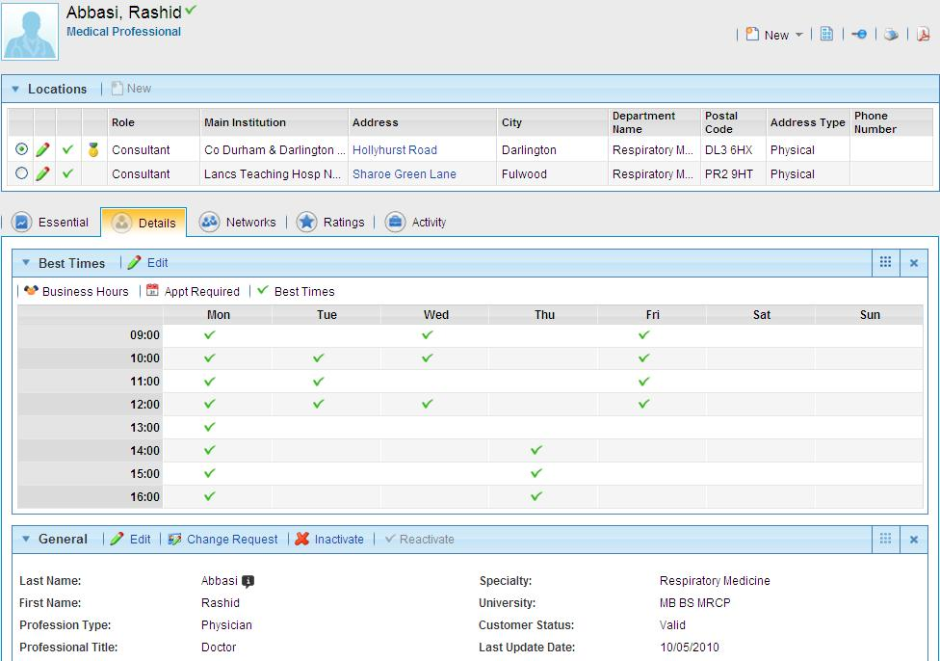
CUSTOMER INFORMATION VIEWING INFORMATION: DETAILS TAB
The Details tab gives
detailed information
about the customer, on the selected address
Best times can be directly edited
Best times can be directly edited
Customer information coming from OneKey can be found on the Details tab
Notes:
Best Times: The appropriate time to visit the customer at this address for each day of the week (Personal information not provided by ONEKEY)
Business Hours: This is the opening times of the office for each address (based on ONEKEY data)

Slide 59
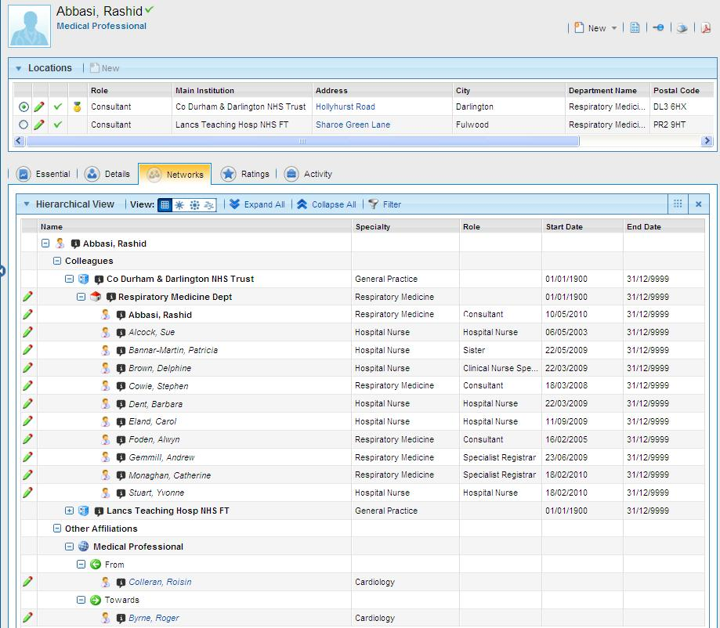
CUSTOMER INFORMATION VIEWING INFORMATION: NETWORKS TAB
Colleagues = Individuals practicing in the same institution or in the departments within the institution (Affiliation Hierarchy = Hard Affiliations)
Not editable by users
Other Affiliations = Soft Affiliations
Editable by users with a drag & drop from the Search/List area specifying the influence
Notes:
4 views are available in the Networks tab:
Grid View (available by default)
Wheel View (available by default)
Diagram View (managed by parameters)
Tag View (managed by parameters)

Slide 60
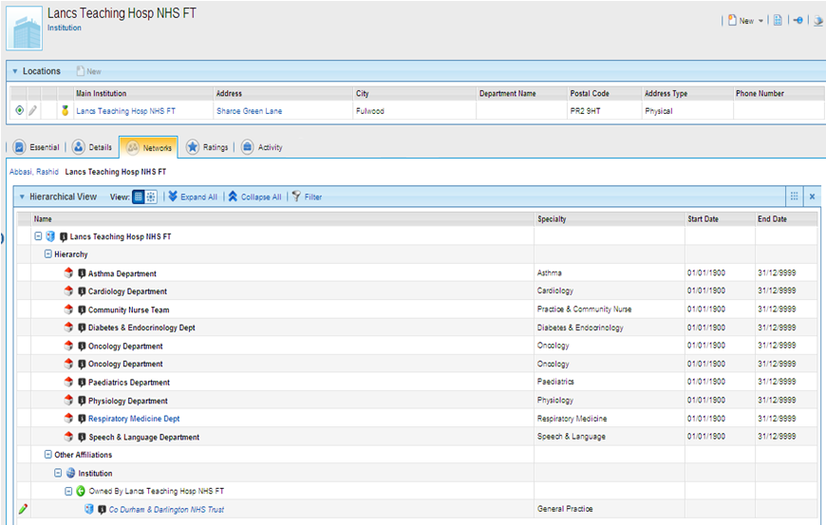
CUSTOMER INFORMATION VIEWING INFORMATION: INSTITUTION NETWORKS TAB
Customer information page is available for all types of customers and information is adapted inside the different tabs.
The Networks tab of an institution provides information on:
hierarchical structure of the institution
affiliations with other organizations

Slide 61
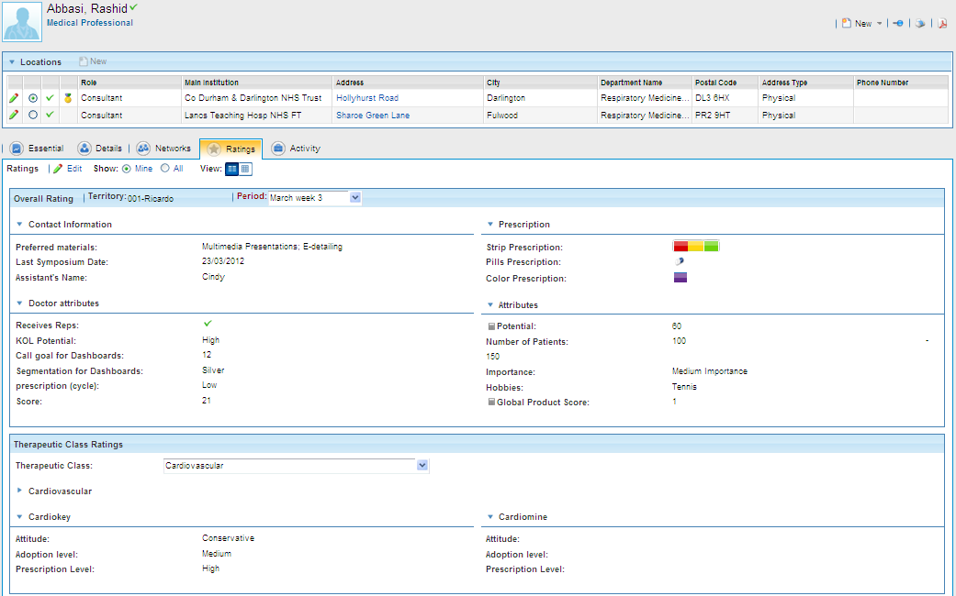
CUSTOMER INFORMATION VIEWING INFORMATION: RATINGS TAB
The Ratings tab gives details on the customer ratings:
Overall Ratings: general qualifying information
Therapeutic class ratings: ratings based on products
(and therapeutic class)
Calculated ratings cannot be modified by the users
Select Therapeutic class to see Product Ratings
Notes:
Via the menu: Functions > Integrated Ratings Editor, it is possible to view, compare and bulk edit customer rating values.

Slide 62
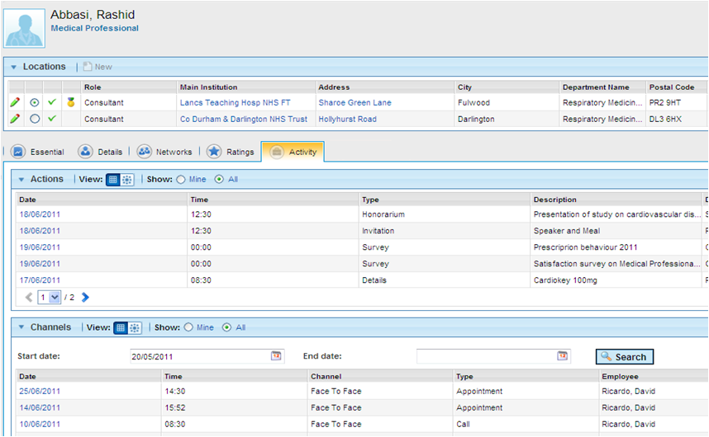
CUSTOMER INFORMATION VIEWING INFORMATION: ACTIVITY TAB
The Activity tab provides all activities done or planned with the customer such as calls, appointments, Investment Requests (meetings), Surveys, multimedia presentations and Plan of Actions information
Navigate through the pages inside the sections to view all the information

Slide 63
SOME MAJOR ICONS IN MOBILE INTELLIGENCE
Icons | Definitions
 | Refers to an Institution
 | Refers to a Department
 | Refers to a Practice
 | Refers to a Pharmacy
 | Refers to a Medical Professional
 | Refers to a Temporary Customers
 | Refers to the Primary Address
 | Refers to the Infotip
 | Indicates you can print
 | Indicates you can configure the page layout
 | Indicates you can edit information
 | Indicates you can export in Excel
 | Indicates you can save on PDF format

Slide 64
PLANNER

Slide 65
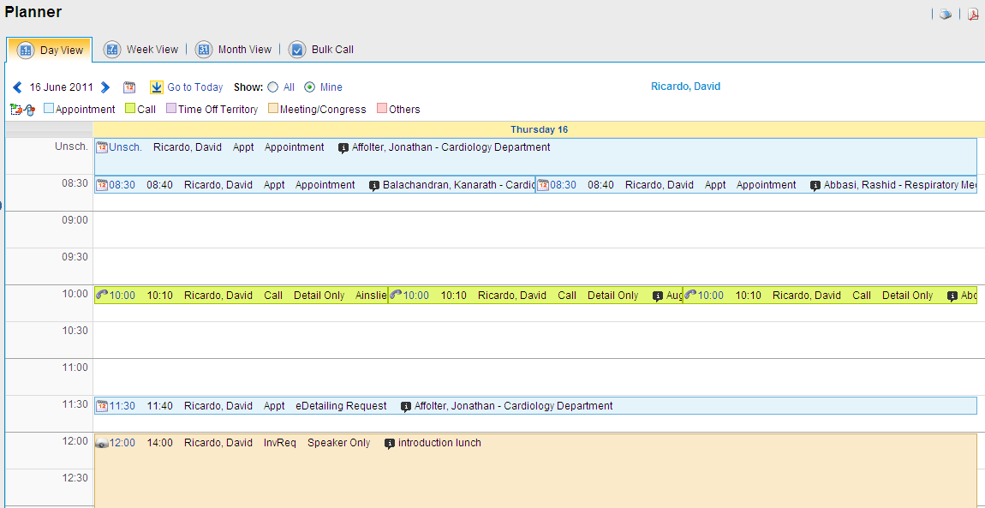
THE PLANNER DAY VIEW
The planning information are mainly concentrated in the planner with 3 different views: By Day, By Week, By Month.
It is possible to display events of colleagues for customers they have in common
Events with no time defined appear in the unscheduled time slot.
Notes:
A parameter that allows the sales representative to see his colleagues planner can be activated.

Slide 66
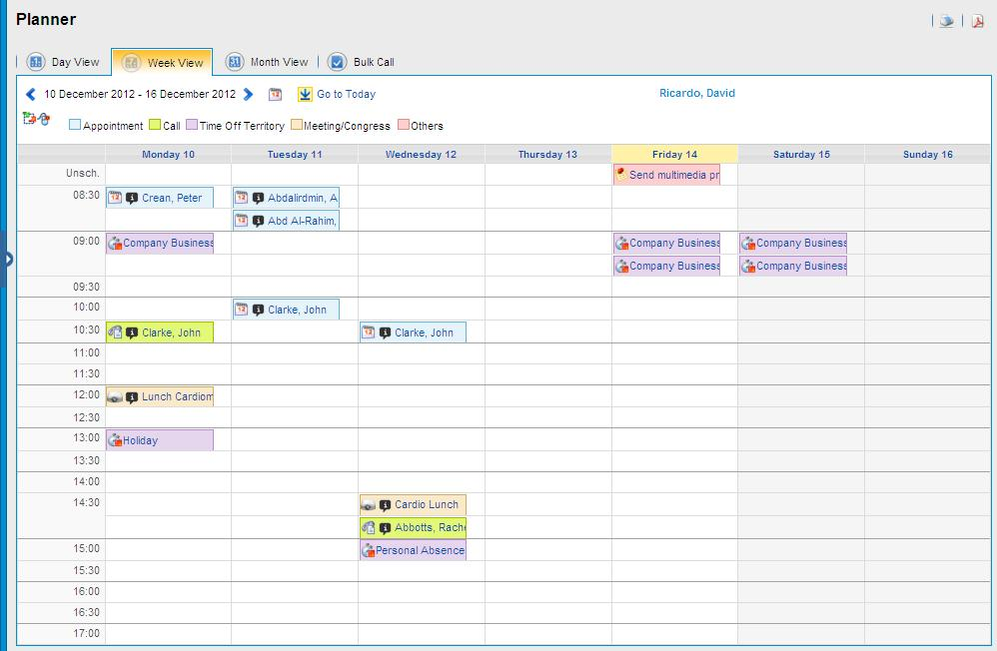

THE PLANNER WEEK VIEW
Several buttons allow to navigate between dates in all the 3 views of the Planner
It is possible to modify the view of the planner in the preferences menu
Notes:
According to parameters defined by configurators, events can be displayed differently on the planner (on day view and week view only):
duration view: Events can be displayed based on the start time and duration with multiple events in one row
stacked view (it is the default one): Events can be displayed as fixed size, one event per row

Slide 67


THE PLANNER MONTH VIEW
In month view, to access the list of events, click the corresponding event type
Direct link to week view
Direct link to day view

Slide 68
THE PLANNER INFORMATION DISPLAYED IN THE PLANNER
In the planner, it enables users to:
Enter and view planned Appointments
Enter and view Time Off Territory
Enter and view a To Do
Enter and view Calls
View Investment Requests (Meetings)
View Field Coaching
View Company Activity and Company Holidays created by the Home Office

Slide 69

THE PLANNER WHAT CAN BE DONE WITH THE PLANNER?
Symbols to indicate that drag & drop and right click actions are possible on this screen
To open the Details page of an event, click it.
Mouse over tooltips display all events details
Notes:
The Others category concerns: To Do, Field Coaching and Company Holidays.

Slide 70

THE PLANNER APPOINTMENTS
When selecting or with a drag and drop of a customer from the Search/List area, the user can create an appointment and view the best times highlighted in green.
Time range for Best Times and Business Hours for this day.
Best Times are personal for the user.
Business Hours are shared within the company.
Best Times slots are highlighted in green
Events that do not concern the selected customer are greyed
Business Hours are highlighted in orange

Slide 71


THE PLANNER APPOINTMENTS
To prepare the call in advance with products to be detailed and participants, use Go to Appointment
One click in the appointment or a right-click / Show Details allows to view the popup with the appointment details
Conflicts section concern other appointments / calls made by the user or other colleagues on this customer.
Appointments can be created in the future and today.
No recurring appointments can be created.

Slide 72

THE PLANNER APPOINTMENTS
User can edit Ratings directly from this screen
A right click opens a menu allowing to perform actions with the selected customer such as creating an appointment
Several locations can be available if the customer has more than one address.
For group appointments, drag and drop customers into the Profiled attendees area.
It is possible to prepare the future call in advance by indicating the products to be detailed and the eventual link with the POA (cycle field)

Slide 73


THE PLANNER APPOINTMENTS
The user can edit appointments by right clicking on the event
Notes:
This feature is not available in the baseline version of MI, it needs to be activated with parameters by the configurator

Slide 74

THE PLANNER APPOINTMENTS
The user can delete appointments, time off territory and to do’s by right clicking on an event
Notes:
This feature is not available in the baseline version of MI, it needs to be activated with parameters by the configurator

Slide 75



THE PLANNER TIME OFF TERRITORY
Time Off Territory (activity other than calls on Customers) can be entered by right clicking the planner schedule.
It is not possible to make recurring Time Off Territory
It appears in the Planner with the type “Out”
Time off Territory can be created in the past, today or in the future.

Slide 76



THE PLANNER TO DO
The To Do item appears in the Planner if this box is ticked.
New To Do (tasks) can be entered by right clicking on the planner schedule.
All the assignees have to mark it as completed in order to complete the To Do entirely
It appears in the Planner...
...and in the Home Page

Slide 77

THE PLANNER TO DO
The status shows the advancement of the To Do
To Do can be linked to customers
To Do can be linked to a module
Notes:
The default color coding of the To Do is:
Green: more than 7 days to complete the To Do
Yellow: between 1 and 7 days to complete the To Do
Red: overdue (either the deadline has passed or it is due today) to complete the To Do

Slide 78
POST-CALL

Slide 79

CALL INSERTION HOW TO CREATE A POST-CALL?
Users can edit Ratings
To enter a call, the user
right-clicks the name of the Customer and selects the Post Call option
It is possible to create calls in
the past and today.
A user will see the calls of
his/her colleagues only if he/she
shares this customer.
Notes:
A Call can be made on all the customers (ex: Institutions, Medical Professionals, Pharmacies, etc)

Slide 80


CALL INSERTION HOW TO CREATE A POST-CALL?
The user fills in the Call details and clicks:
- Save for later to review the call before sending it
- Finish to conclude the call (not editable anymore)
This symbol indicates that the customer can receive samples at this address.
It is possible to indicate in the post-call the number of samples dropped.
Product Messages are created by the HO and the Rep can select them to provide additional information about the Product detailing
The users can detail as many products as they need

Slide 81

CALL INSERTION HOW TO CREATE A POST-CALL?
Bottom half of Post-Call screen
Call-related expenses can be added to the Post Call
The next call objective can be added to a call as a reminder; however, a future appointment is not necessary
Call notes and To Dos can be added
Download Document available from the user’s computer or from the HO

Slide 82

CALL INSERTION HOW TO CREATE A POST-CALL?
When entering the call, the user can edit the call dialogue
Call Dialogue is a predefined series of questions, intended to be used by a Sales Representative in a Post-Call to report extra information about the call or Customer

Slide 83

CALL INSERTION HOW TO CREATE A POST-CALL?
Presentations allows to show presentations to the customer, such as videos, PowerPoint...
Notes:
To have Multimedia Presentations module available in the PC, Advanced Detailing (CLM) module must not be activated by the configurator. Indeed Advanced Detailing (CLM) is for MI Touch.

Slide 84

CALL INSERTION HOW TO CONVERT AN APPOINTMENT TO A CALL?
Selecting an appointment, the user
right-clicks and selects: Convert to Call

Slide 85


CALL INSERTION HOW TO EDIT A CALL?
The user can edit Calls by right clicking on the event
Notes:
This feature is not available in the baseline version of MI, it needs to be activated in the parameters

Slide 86
LIST BUILDER

Slide 87
THE LIST BUILDER WHAT IS THE LIST BUILDER?
With List Builder, Sales Representatives, District Managers, Regional Managers and Home Office users can:
Create and share lists of Customers, based on very specific criteria in a quick process (e.g.: Rating values, Specialty, etc)
Quickly analyze information inside Mobile Intelligence
Generate attendee lists for various purposes (e.g.: Congresses)
Create intuitive lists thanks to the logical work order flow

Slide 88

THE LIST BUILDER HOW TO CREATE A LIST?
Any user can create, share and classify lists
based on various criteria in List Builder
When sharing a list,
only the criteria of
the list are shared.
It is necessary
to execute it.
HO users have also
“POA folder” lists.

Slide 89

THE LIST BUILDER HOW TO CREATE A LIST?
Manual List is a list which
remain static
Targeting: list available only in the
List Builder menu
Report: list available in the List
Builder and also in the Reports menu
If ticked, this list will be accessible through “My List” on the Home page and in the Search/List area

Slide 90


THE LIST BUILDER HOW TO CREATE A LIST?
The user can define the constraints of the list
The user can choose between various constraints
The user can refine the constraints
Notes:
The constraints depend on the list Type.

Slide 91


THE LIST BUILDER HOW TO CREATE A LIST?
The user can choose which headings will be shown in the list
The user can refine the headings

Slide 92


THE LIST BUILDER HOW TO VIEW & EXPORT LIST RESULTS?
Refresh enables to update data displayed in the result list
A right click opens a menu allowing to perform actions with the selected customer(s)
Execute enables to run the constraints and obtain a new list
Possibility to export a list to Excel

Slide 93
REPORTS

Slide 94
THE REPORTS WHAT ARE THE REPORTS?
With the Reports, it is possible to:
Monitor the user’s progress
Access a quick and accurate analysis
Have easy to read results

Slide 95


THE REPORTS HOW TO VIEW THE REPORTS?
The reports give the opportunity
to perform analysis based on
various pre-defined criteria
Notes:
Details on some basic reports:
- Best Times: Health professional the user can call according to the Best Times he/she filled in
Business Hours: Health professional availability based on Business Hours the user filled in
Planner Activity: Time Off Territory planned on a specific period
Field Coaching Activity: Provides a view of the field coaching activities for one or more representatives within the user’s hierarchy

Slide 96

THE REPORTS HOW TO VIEW THE REPORTS?
The information in the result is also
pre-defined.
Notes:
The result of the report can be exported through Excel.

Slide 97
MI TOUCH INTRODUCTION

Slide 98

INTRODUCTION – MI TOUCH
Dedicated Home Page
Primary/Specialty Care

Slide 99

INTRODUCTION – MI TOUCH
Medical Inquiry
KAM
Compliance

Slide 100


INTRODUCTION – MI TOUCH
District Manager Home Page
The District Manager can access MI Touch using Safari on an Ipad
District Manager Planner
With this feature the District Manager can check the information of his/her Sales Representatives (Planner, To Dos, etc)

Slide 101
MI TOUCH: WHAT IS IT?
Next Generation Mobile CRM App
Optimized for field users
Primary and Specialty Care Sales Representatives
Key Account Managers
Medical Science Liaisons
Leverage iPad capabilities
GPS, Electronic Signature, Multimedia

Slide 102
MI TOUCH: WHY?
Tailor-made solution for iPad
High Performance
Simple & fast
It’s truly Mobile!

Slide 103
USEFUL COLLATERALS
For any additional product information click here:
http://crm.cegedim-portal.com/resource/Product/MI/Pages/mi9.aspx?
Now let’s see the real thing…
Notes:
Pricing details can be requested from the Corp Pricing Team

Slide 104


MI TOUCH – LOGGING ON
Enter Login and Password
Notes:
Login and password are provided by the Administrator of Mobile Intelligence.

Slide 105
MI TOUCH – HOMEPAGE
Search
Actions & Alerts
KPIs
Links to modules
Notes:
Actions and Alerts: Only the 3 most recent ‘message of the day’ and/or ‘Urgent Attention’ messages are displayed (all the items are accessible in the Notifications link on the Home Page)
The figure beside the Planner indicates the number of appointments for the day
The figure beside the Incomplete Calls indicates the number of calls that have been saved for later
The figure beside the To Do indicates the number of ‘open’ To Dos
The figure beside the Meetings indicates the number of ‘non-closed’ meetings (e.g.: shared, submitted for approval...)
The App supports both on-demand and automatic synchronizations
KPIs: Only two Key Performance Indicators can be displayed on the Home page (it depends on a parameter setting).
The corresponding data can be automatically calculated (in the Scheduler Manager of FA) or loaded via standard interfaces.

Slide 106

MI TOUCH – HOMEPAGE (NO CONNECTIVITY)
Some Features are not available when Internet
connectivity is lost.
Multimedia
Presentations
Notes:
Available features from the Home Page when working in disconnected mode on MI Touch:
Planner
Incomplete Calls
To Do
Notifications
Route Builder
Multimedia Presentations
Tools
Analytics (Roambi)
Change Request
Available features from the Home Page when working in connected mode on MI Touch:
Near Me
Plan of Action
Materials
Expenses
Meetings
Reports

Slide 107

NAVIGATION BAR
At the bottom of each screen of the application, except the Home page and all the pages that are in edit mode, the navigation bar enables the user to access some main functions of the MI Touch application.
Home & Search icons available throughout the App
Functions: give access to other features

Slide 108


MI TOUCH – CUSTOMER SEARCH PAGE
One or more criteria can be selected
Individual search using a constraint
Continue Search on server link allows a user to search for other Customers with the same name (first, last or partial) as a Customer that is already aligned to them
Notes:
Intuitive search possibilities: for instance, when searching the letter “k” for an individual (Med Prof & Business Contacts), MI Touch shows first names AND last names beginning with the letter “k”.

Slide 109


MI TOUCH – PRESET LISTS
When tapping on All Customers, users can access Preset Lists defined and shared by the HO users.
Only the customers aligned to the user are listed.
Notes:
Preset Lists are ‘Predefined Lists’ created with SQL statements by HO users with advanced configuration permissions (they are not coming from List Builder).
By default, there are 5 existing “out-of-the-box” :
Customers Added by Onekey
Customers Updated by Onekey
Targets not seen for 3 months
KOL Customers
Speaker Customers

Slide 110

MI TOUCH – CUSTOMER INFORMATION
MI Touch provides sales representatives with up-to-date, relevant Customer information
Address information
Affiliations
Ratings
Change Request

Slide 111

MI TOUCH – CUSTOMER MANAGEMENT
Customer Information is stored on different tabs
Users can interact with the customer

Slide 112

MI TOUCH – CUSTOMER MANAGEMENT
Click on name to switch address, modify address or make it as primary
Click on General to make an update Change Request or directly modify information on this customer

Slide 113

MI TOUCH – CUSTOMER MANAGEMENT
Users can access Location Information such as Best Times (Address Based)

Slide 114


MI TOUCH – CUSTOMER MANAGEMENT
Users can access & modify Ratings Information

Slide 115

MI TOUCH – CUSTOMER MANAGEMENT
Users can access the Activity History: Appointments, Calls, Meetings, Medical Inquiries

Slide 116





CUSTOMER PROFILE ACTIVITY HISTORY TAB
They can even access details of each activity

Slide 117

MI TOUCH – CUSTOMER MANAGEMENT
Users can access the active surveys for this customer
Users can access the Affiliations of customers (Hard Affiliations)

Slide 118

MI TOUCH – CUSTOMER MANAGEMENT
Users can manage Soft Affiliations here
Users can access the active surveys for this customer
Users can manage the Influences between customers (Soft Affiliations)

Slide 119


MI TOUCH – CUSTOMER MANAGEMENT
Get a better understanding of the activities of the Customer by using the OneKey social Media data in MI Touch
Notes:
New data package is available as part of the OneKey data packs
Once the data is purchased, these fields can be added to a section on a Customer Profile or a new tab (here, Digital Profile) can be created via configuration to display the results as shown

Slide 120



MI TOUCH – PLANNING ACTIVITIES
Planner (Day view)
Mark the To Do as complete
Convert Appt to Call
Day view of planner with Calls, Appointments, Meetings, Time Off Territory, To Dos
Notes:
The incomplete calls are also listed.

Slide 121


MI TOUCH – PLANNING ACTIVITIES
Planner (Week view)
Tap on an event to access to its details.
Notes:
The default color coding is:
in green: Calls
in blue: Appointments
in purple: Time Off Territory
in pink: To Dos
in orange: Meetings
It is possible to synchronize appointments to the iPad client Mail and integrated calendar only if the rep uses Outlook Sync pluggin on the laptop (online or offline).

Slide 122


MI TOUCH – PLANNING ACTIVITIES
Appointments can be made from the Customer profile page or from the planner
Appointments can be made from the Customer profile page or from the planner

Slide 123

MI TOUCH – APPOINTMENT
Appointments can also be made from the Quick Search or from the Customer profile

Slide 124


MI TOUCH – APPOINTMENT
If the Appointment is created from the Planner, the user has to select a customer
The user has to fill in the Appointment details (Date, Duration, Cycle...) and he can have information about conflicts existing calls or appointments.

Slide 125
MI TOUCH – TIME OFF TERRITORY
Time Off Territory can only be created from the planner

Slide 126

MI TOUCH – TIME OFF TERRITORY
The user fills in the Time Off Territory to indicate an activity such as Holidays, Company Business

Slide 127
MI TOUCH – TO DO
To Do can be created from the planner or the home page

Slide 128


MI TOUCH – TO DO
The user fills out the fields for the To Do.
The user can assign this To Do to another colleague. By default, the To Do is for the user himself/herself;

Slide 129

MI TOUCH – TO DO
A list of “open” To Dos is accessible from the Home Page
Personal: Created by the user him/herself for him/herself
Received: Created by the user him/herself or a colleague for the user included
Sent: Created by the user him/herself and dispatch to colleague(s)
A user can mark the To
Do as complete or
Reject the To Do.
The default color coding is:
in green: On Time
more than 7 days to complete the To Do
in yellow: In Jeopardy
between 1 and 7 days to complete To Do
in red: Overdue
either the deadline has passed or it is due today) to complete To Do
Notes:
The completed and rejected To Dos can no longer be found from MI TOUCH.
Personal To Do's give me information about my own tasks, for instance a reminder to pick up brochures (related to a customer or a general to do).
Received To Do’s are tasks that included me as one of the recipients. I can create a to do for myself and a colleague, or a colleague can send a to do to me.
Sent To Do’s are the To Do’s that I created for other colleagues from my company (I am not included in the recipients).

Slide 130

MI TOUCH – TO DO
A To Do can be associated with a MI Touch function (when it was created within a customer profile, a call...).
Tapping on the Link button, it opens a pop up allowing to access to the associated function.

Slide 131

MI TOUCH – CALL
Calls can be created from different places using MI Touch:
From the Search
From the Customer Profile
From the Planner

Slide 132

MI TOUCH – CALL
It is also possible to convert an Appointment into a Call

Slide 133


Advanced Detailing (CLM)
Advanced Detailing (CLM) is a module allowing the reps to deal with multimedia presentations in MI Touch
A notification will inform the user that a new presentation is available
MI Touch Reps

Slide 134


Advanced Detailing (CLM)
Tap the icon Presentations to open the module
Field users can begin the download to recover a Presentation on MI Touch

Slide 135


Advanced Detailing (CLM)
Once the presentation has been downloaded, the user can check some information about it

Slide 136


Advanced Detailing (CLM)
The presentation can be played in front of a Medical Professional or previewed by the user
The preview will not record data, but rather allows the user to become familiar with the content

Slide 137


Advanced Detailing (CLM)
Capturing hidden feedback
Notes:
Screenshot taken using Safari web browser to show the hidden zones of feedback. These are not visible on MI Touch (the screen simply fades once feedback is recorded by the user)
Only if the sequence is linked to a key message

Slide 138

MI TOUCH – CALL (SIGNATURE)
Including the possibility for the customer to sign for the presentations, samples and/or medical inquiries

Slide 139

MI TOUCH – CALL
At the end, the user can Save for Later or Finish the entire Call.

Slide 140
Thank you…
Email: Corp.CRM.Trainers@cegedim.com
www.cegedim.com/rm

